Slide 1
Review on single-cell RNA-Seq
Focus on Immunology and Cancer
David Gfeller
Computational Cancer Biology
Ludwig Center for Cancer research
david.gfeller@unil.ch

Slide 2
Gene expression profiling
Widely used in biology for unbiased analysis of which/how much a gene is expressed in a sample.
  Microarrays ( 2000 – 2010 )
  RNA-Seq ( 2005 -> now )
One of the main application: compare the level of expression between samples.

Slide 3
RNA-Seq
RNA fragmentation
Reverse transcription
Adaptors + amplification
Sequencing
ACCTAG…
CGGTAA…
ATGGCA…
TGGGAC…
TATAGG…
>100M reads
Map to reference transcriptome
RNA
Gene A
Gene B
Gene expression => Quite easy (count the reads)
Gene fusion => More difficult (especially for new fusion events)
Splicing => More difficult (especially for poorly annotated isoforms)
Measured expression is the average over all cell types

Slide 4
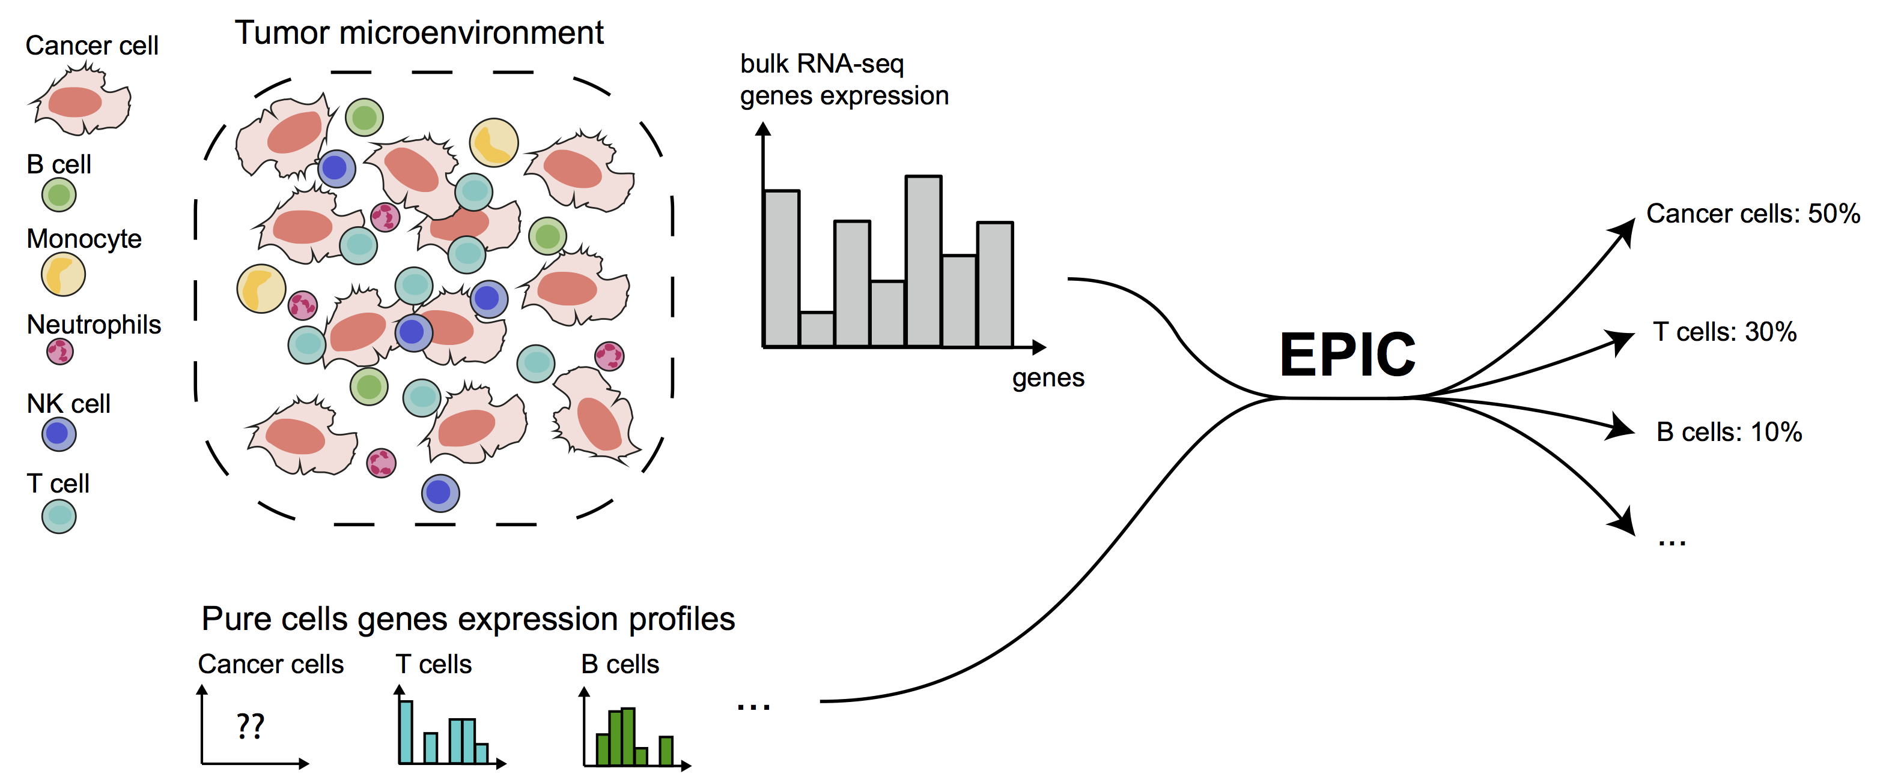
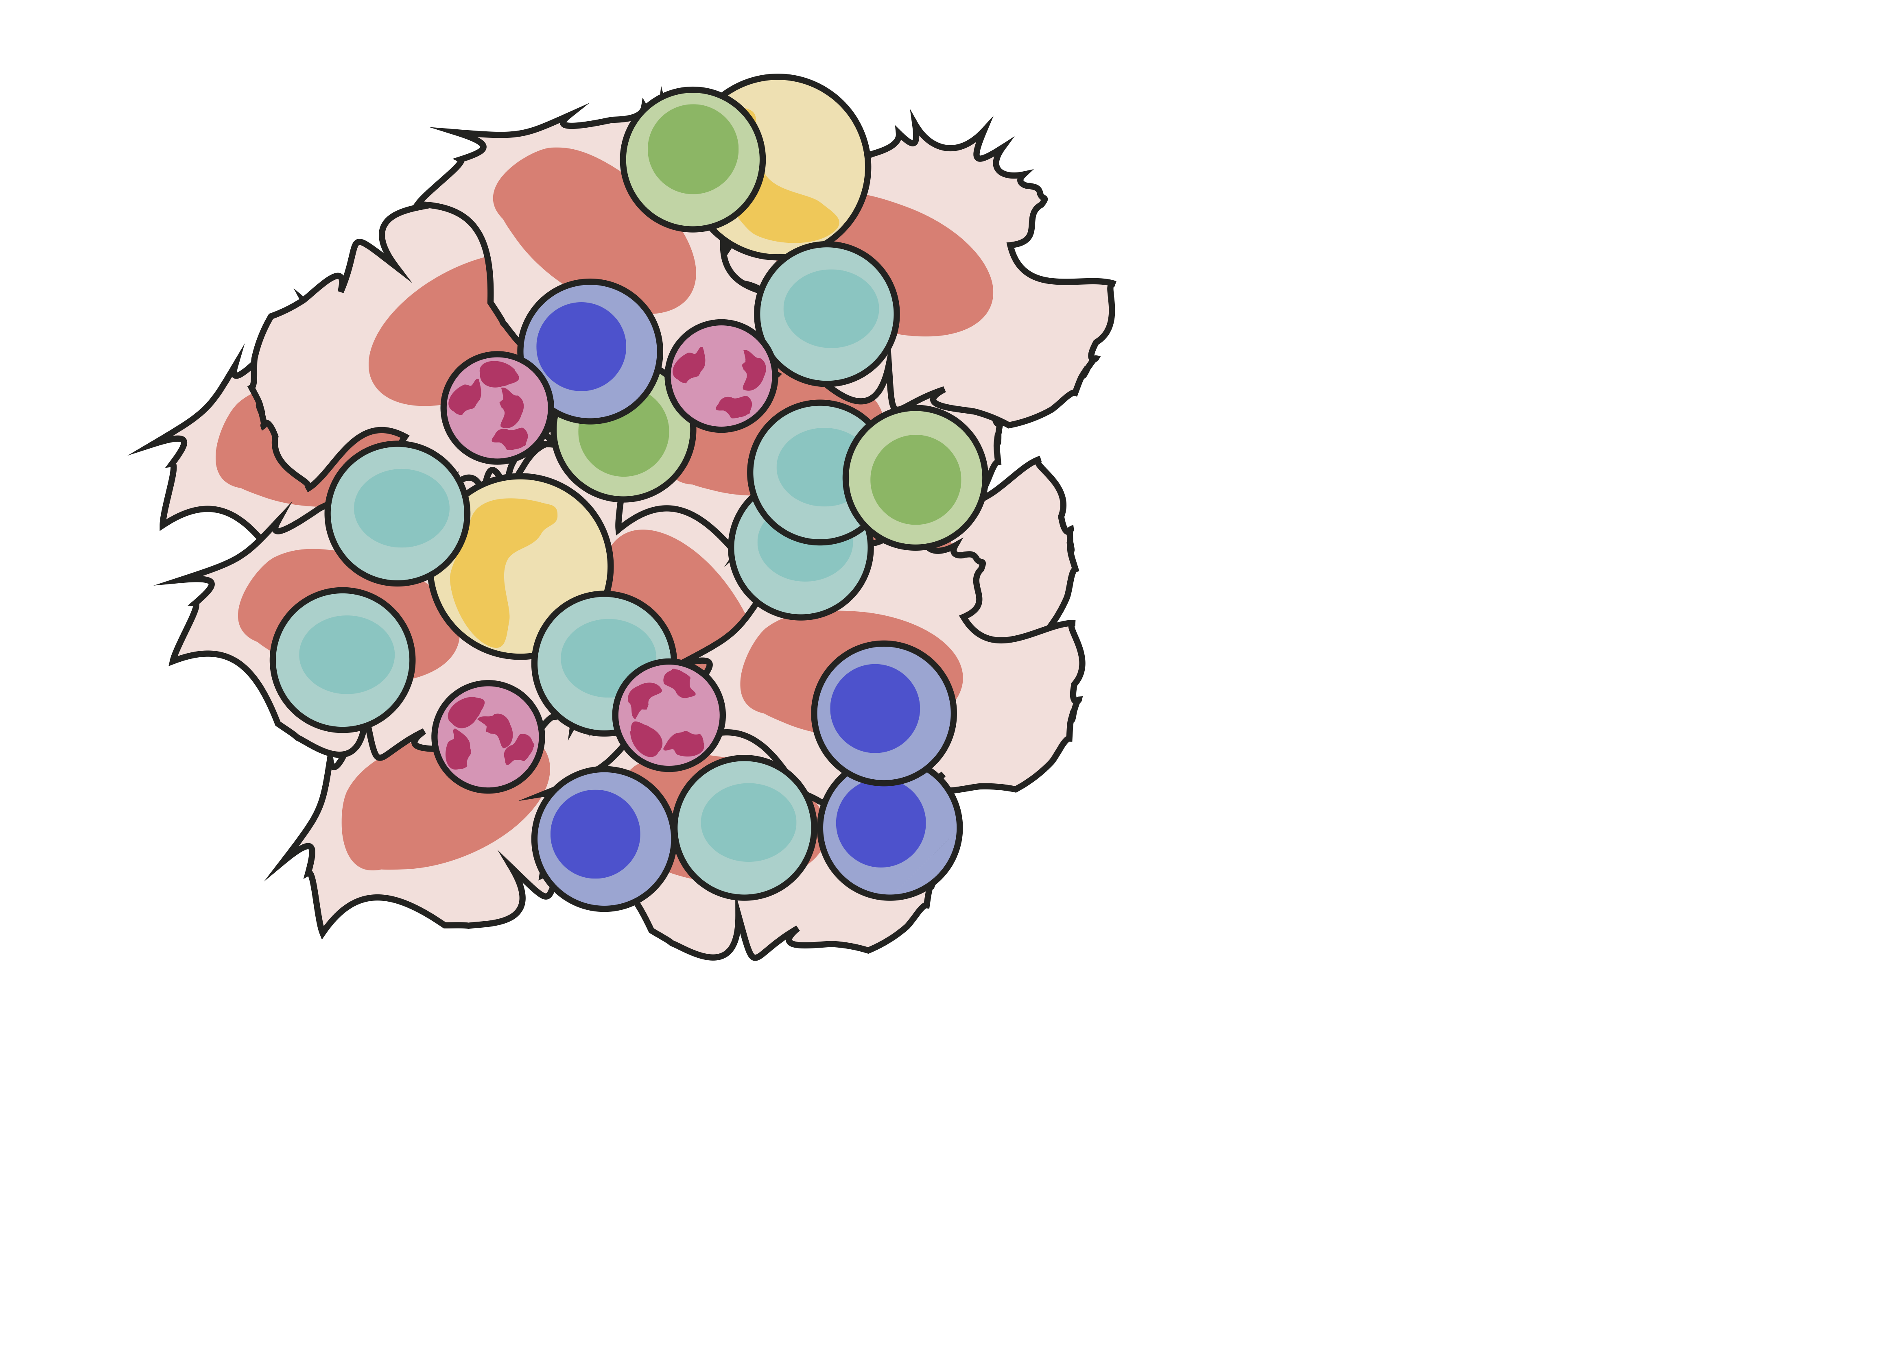

Single-cell RNA-Seq – Motivation
Bulk sample gene expression analysis
Different expression in different cell types in mixed sample
gene1
gene1
Same average
T1
T2
T1
T2
Examples
Bimodal expression in a pure sample
We have information about all cell types
The signal is mixed with other cell types
Same average
Possible in some cases to infer the fraction of the different cell types, but impossible to infer their actual gene expression profile

Slide 5
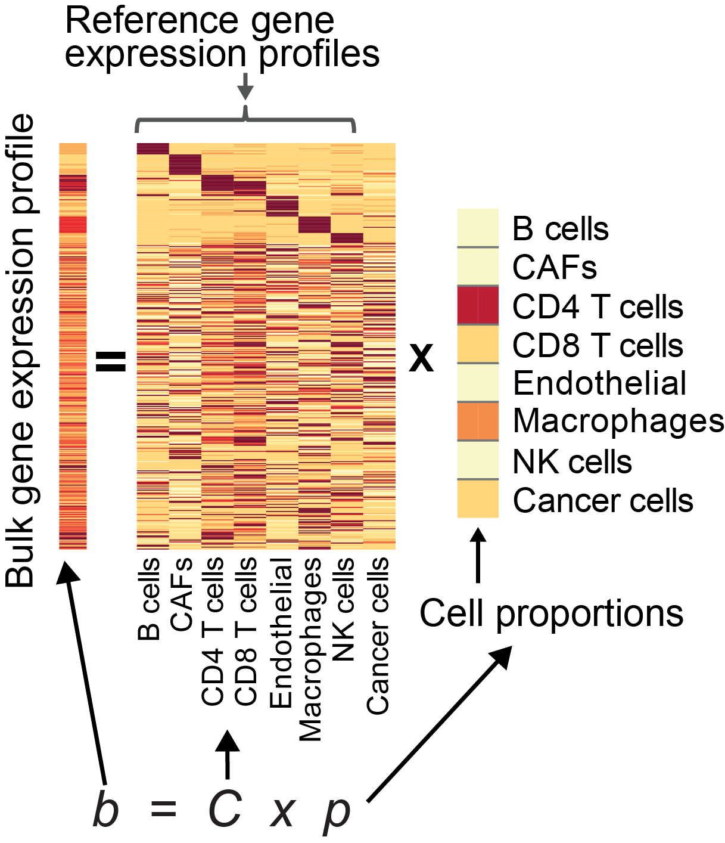
Quantitative predictions of cell fractions from bulk gene expression
New approach developed in my lab: allowing for an uncharacterized cell type
Immune cell type decomposition
expression
genes
p₁
p₂
p₃
Cell type 1
Cell type 2
Cell type 3
Least-square minimization problem

Slide 6
Different methods
EPIC: Estimating the Proportion of Immune and Cancer cells from bulk tumor gene expression data (Racle et al.,eLife 2017).
CIBERSORT: Many types of immune cell reference profiles (Newman et al. Nat Meth. 2015).
TIMER: Main immune cell types (Li et al. Genome Biology 2016).
MCPcounter: Immune + stromal cells, good performance, but results not comparable across different cell types (Becht E et al. Genome Biology 2016).
In many cases, these methods can be used to infer the fractions of the main cell types, but it fails (i) to predict the fraction of rare cell types (<5%) (ii) to predict the actual gene expression profile of the cell types.

Slide 7
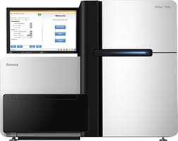
4 - Introduction to single-cell RNA-Seq
Retro-transcription
Amplification
Barcoding
Library prep
Cell suspension
Capture
Sequencing

Slide 8
Different techniques
Flow Cytometry:
  Load single cells on 96/384-well plates
  RNA processing with Smart-Seq2 protocols
Fluidigm:
  Microfluidic device for cell capture and RNA processing
Drop-Seq:
  Isolate cells in oil droplets with all the reagents for library preparation
Genome10x:
  Optimized capture

Slide 9
Comparison
 | Through-put | Cost | Quality | Main advantages | Main issues
Flow cytometry | Low (100-1000 cells) | High | Quite high (5’000 genes detected) | Sorting, Staining, | Cost
Fluidigm | Low (100-1000 cells) | Quite high | Decent | Automated capture | High rate of doublets
DropSeq | High (10’000s cells) | Lower | Still less good coverage | High-throughput | Still lower coverage
Genome10X | Very high (10’000s cells) | Lower | Almost as good as flow cytometry | Automated | Still expensive, but increasingly taken as the technic of choice

Slide 10
Promises of single-cell RNA-Seq
  Unbiased identification of (new) cell types
  Monitoring changes in gene expression in each cell type separately
  Predictions of new markers
  TCR or BCR reconstruction in T and B cells (more generally, DNA barcoding for cell tracking)
  Reconstruction of differentiation processes
Example from comparative immunology

Slide 11
Promises of single-cell RNA-Seq
  Unbiased identification of (new) cell types
  Monitoring changes in gene expression in each cell type separately
  Predictions of new markers
  TCR or BCR reconstruction in T and B cells (more generally, DNA barcoding for cell tracking)
  Reconstruction of differentiation processes

Slide 12
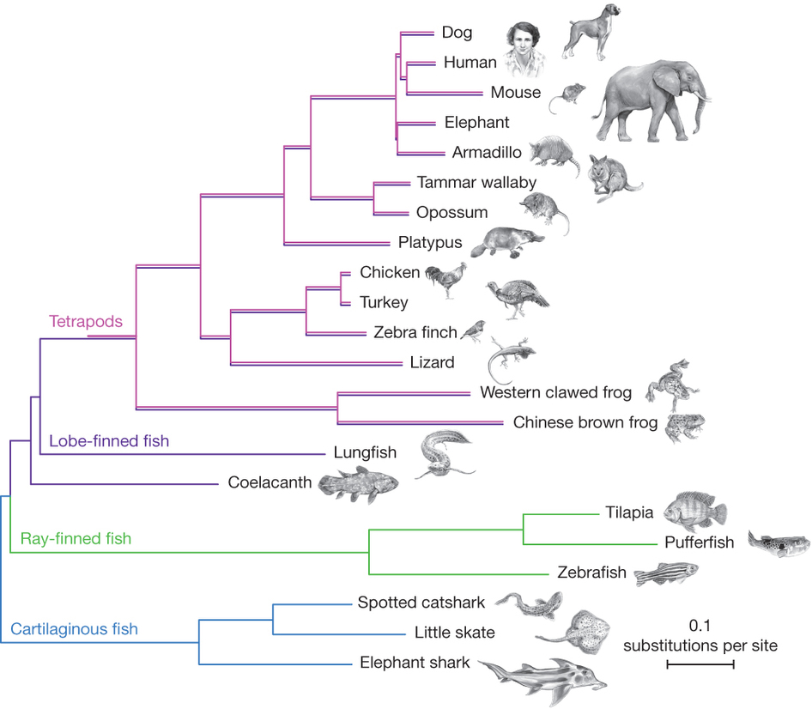
Cell type identification – example of immune cell in zebrafish [Carmona,…, Gfeller Genome Research 2017]
Most of our understanding of immune cells come from mouse or human
Adaptive immune system
(TCR, BCR, RAG, MHC)
Little known beyond mammals:
Lack of lineage-specific antibodies

Slide 13

Single-cell transcriptomics of lck+ cells in zebrafish
GFP+ single-cell
FACS index sorting
lck:GFP line
Spleen dissection
FSC+SSC+GFP
Smart-Seq2
Single-cell + bulk
RNA-Seq
Ana Cvejic and Sarah Teichmann
Sanger Institute, UK
278 single-cell transcriptomes
[3 samples, 2 fish]
Illumina Sequencing & data processing
[Carmona,…,Gfeller Genome Research 2017]

Slide 14
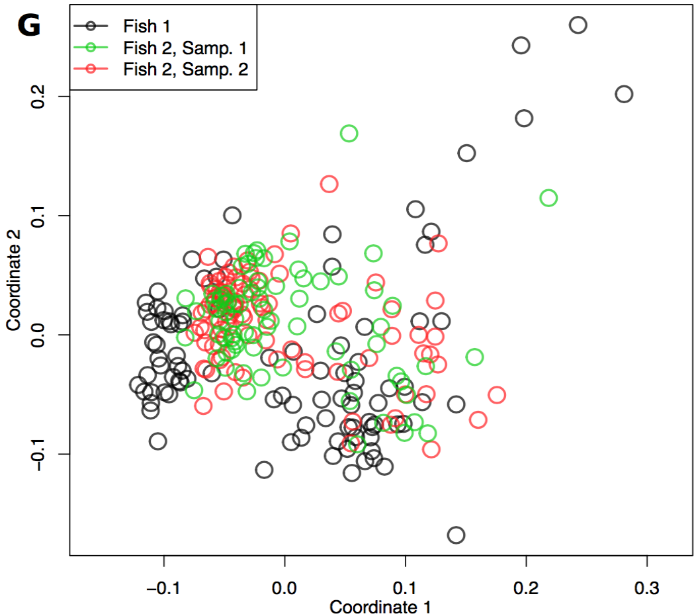
Single-cell transcriptomics of lck+ cells in zebrafish
Single cell RNASeq data:
MDS – 2D
~12’000 genes
263 cells
Dimensionality reduction
Multi-dimensional scaling:
Preserves distances in 2D

Slide 15
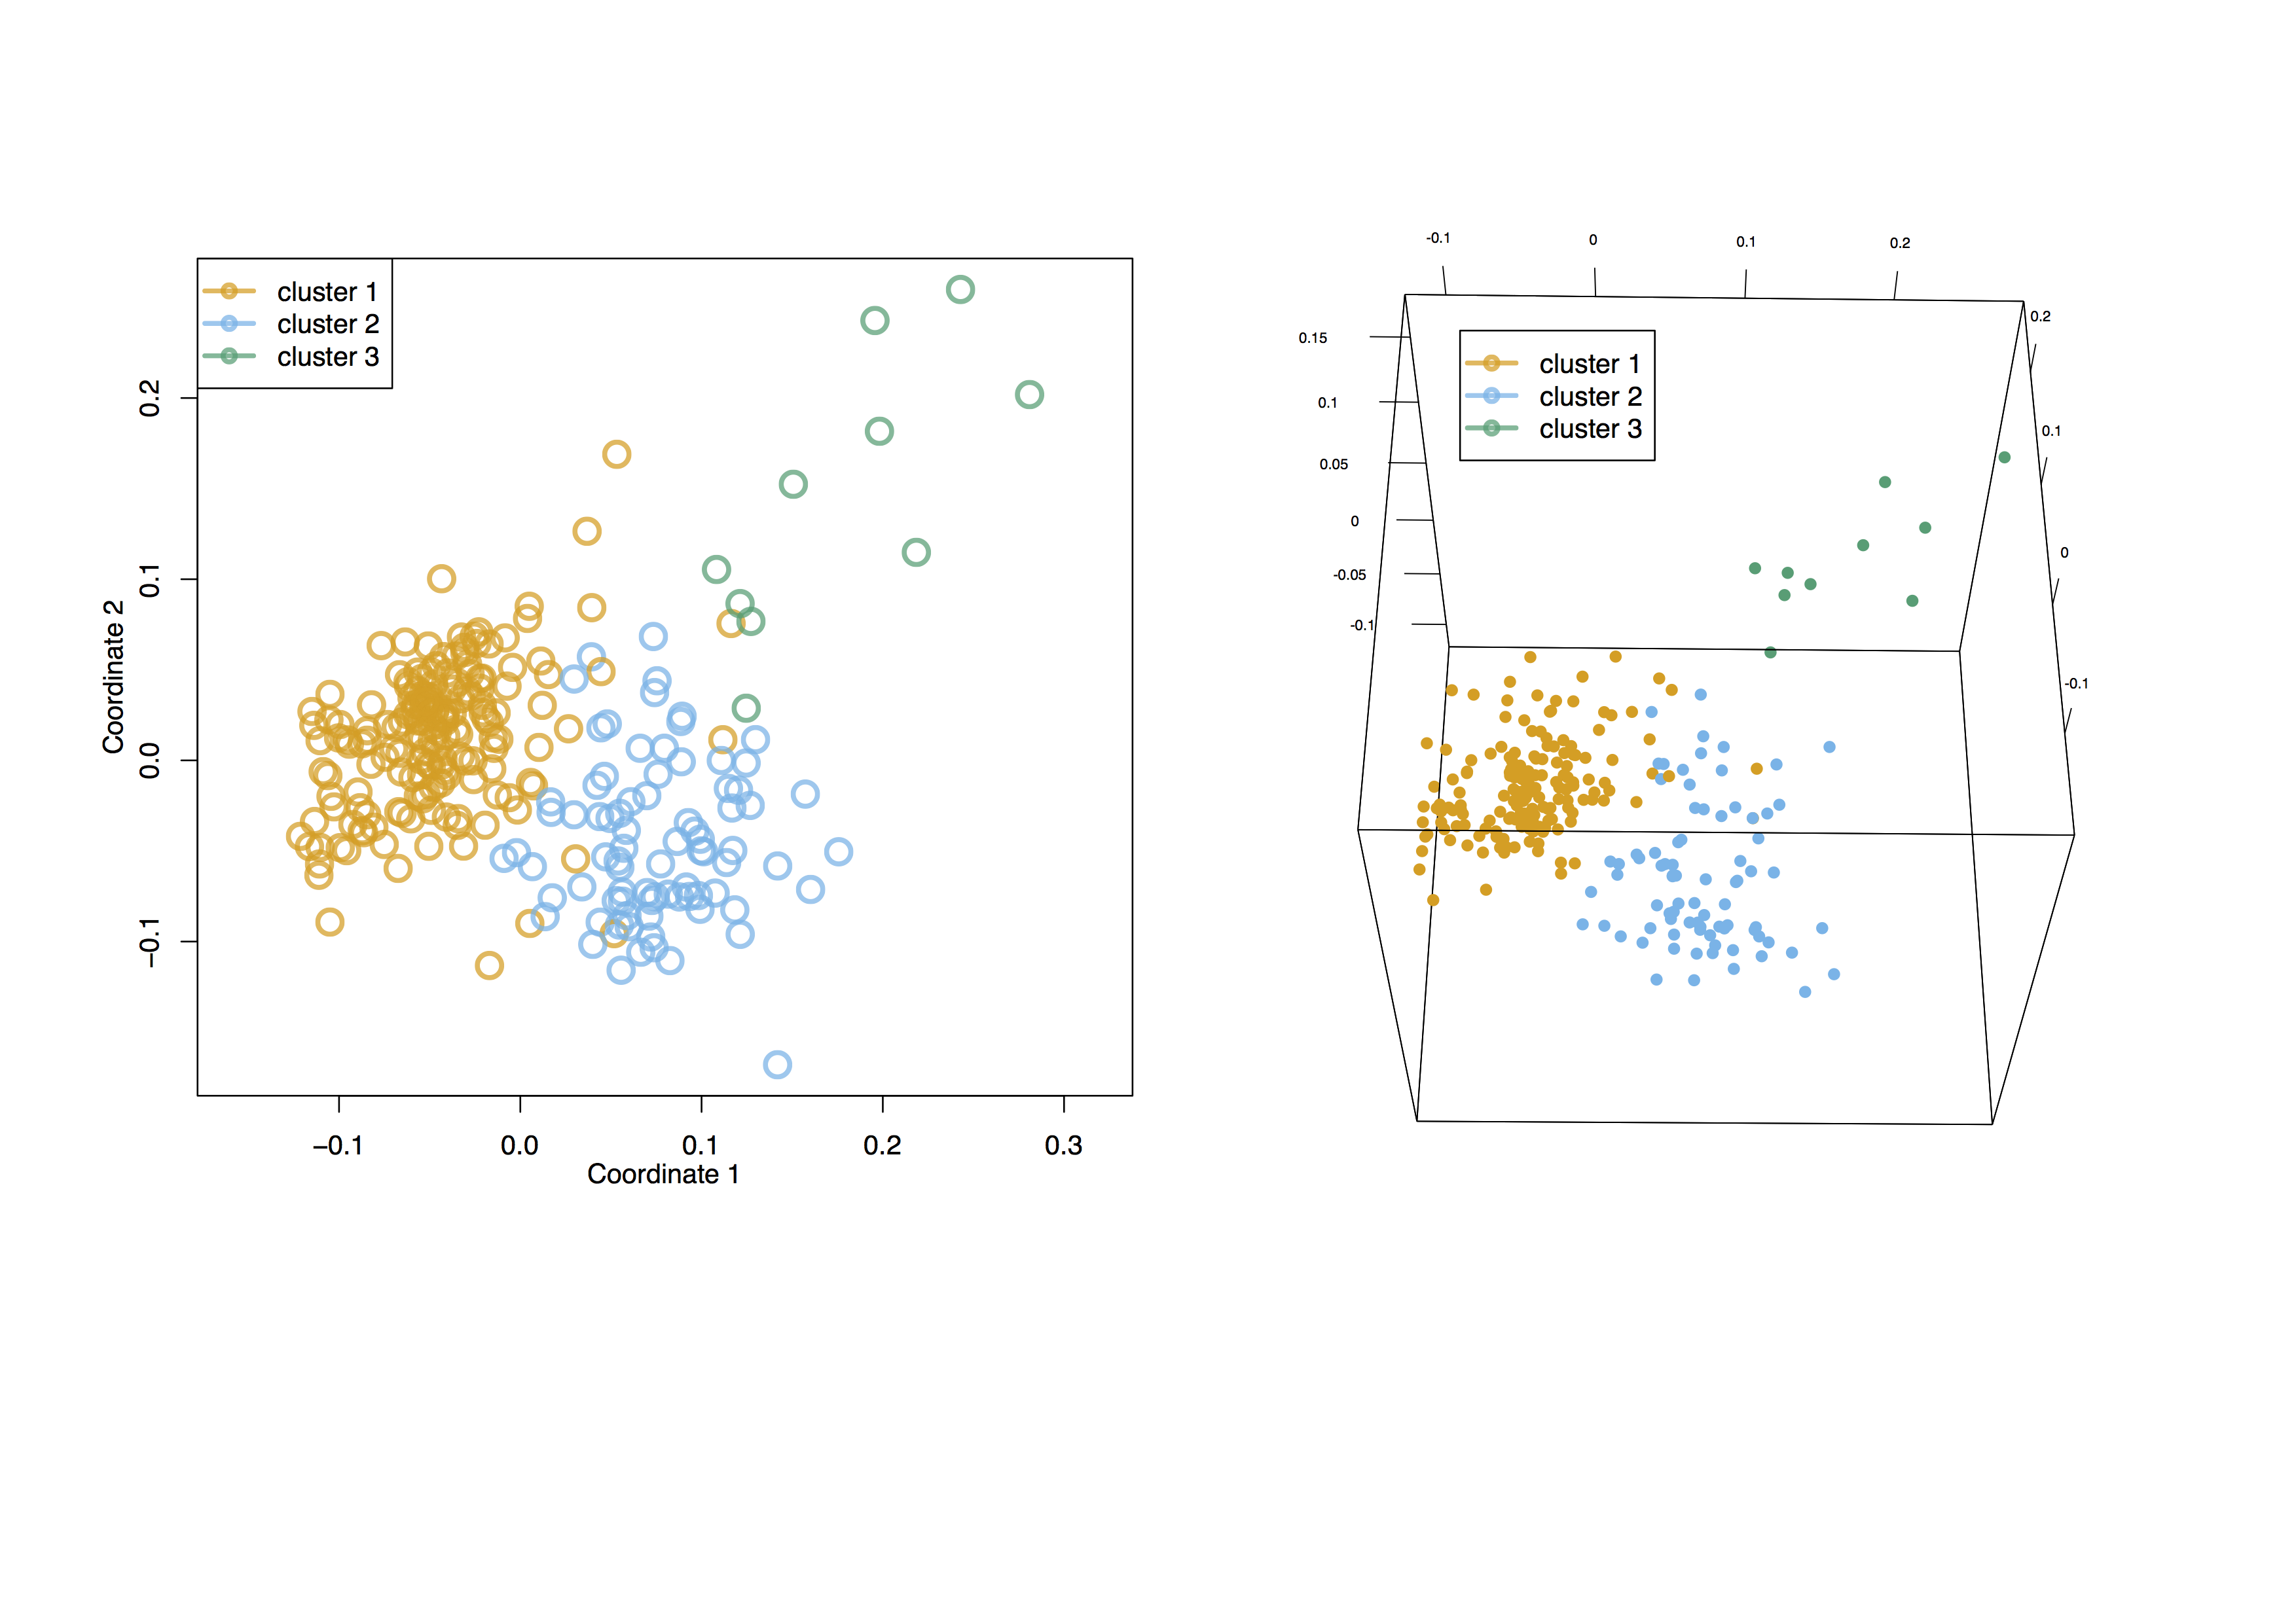
Clustering
3 main clusters
(max silhouette coefficient)
3D view
In mammals, Lck is expressed in both T and NK cells, and some myeloid cells.

Slide 16
Cluster annotation
Myeloid cells
T-cell
NK-cell
Known markers of cell type are very clearly expressed in distinct clusters.
First evidence of NK cells in non-mammalian species
[Carmona,…, Gfeller Genome Research 2017]

Slide 17
Cell-type identifications in single-cell RNA-Seq data
Clustering and low-dimensionality reduction techniques.
Annotate the clusters based on known markers.
If not possible with clustering, directly use markers (but more noisy and not unbiased).
Always try to validate (e.g., forward and side-scatter or staining when using flow cytometry, imaging).

Slide 18
Promises of single-cell RNA-Seq
  Unbiased identification of (new) cell types
  Monitoring changes in gene expression in each cell type separately
  Predictions of new markers
  TCR or BCR reconstruction in T and B cells (more generally, DNA barcoding for cell tracking)
  Reconstruction of differentiation processes

Slide 19
Differential expression between clusters
T cells:
tcf7
cd8a
ctla4
cd28
NK cells:
prf1.2
gzm-like
nitr
fasl
Myeloid-like cells:
nkl.3
spi1b
csf2rb

Slide 20
Promises of single-cell RNA-Seq
  Unbiased identification of (new) cell types
  Monitoring changes in gene expression in each cell type separately
  Predictions of new markers
  TCR or BCR reconstruction in T and B cells (more generally, DNA barcoding for cell tracking)
  Reconstruction of differentiation processes

Slide 21
TCR reconstruction
V1
V2
V3
V4
D
J1
J2
J3
J4
Take all V, D and J regions
V1
J1
V1
J2
V1
J3
V1
J4
V2
J1
V2
J2
V2
J3
V2
J4
Build all possible rearrangements
…
Map RNASeq reads to this synthetic genome
V1
J4
Reconstruct contigs that span both a V and J regions
V1
J4
Automatic pairing of alpha and beta chains
Many resources (R/python):
TraCer: Stubbington et al. Nat Meth 2016
VDJPuzzle: Eltahla et al., Immunol Cell Bio 2016
TRAPeS: Afik et al., NAR 2017

Slide 22
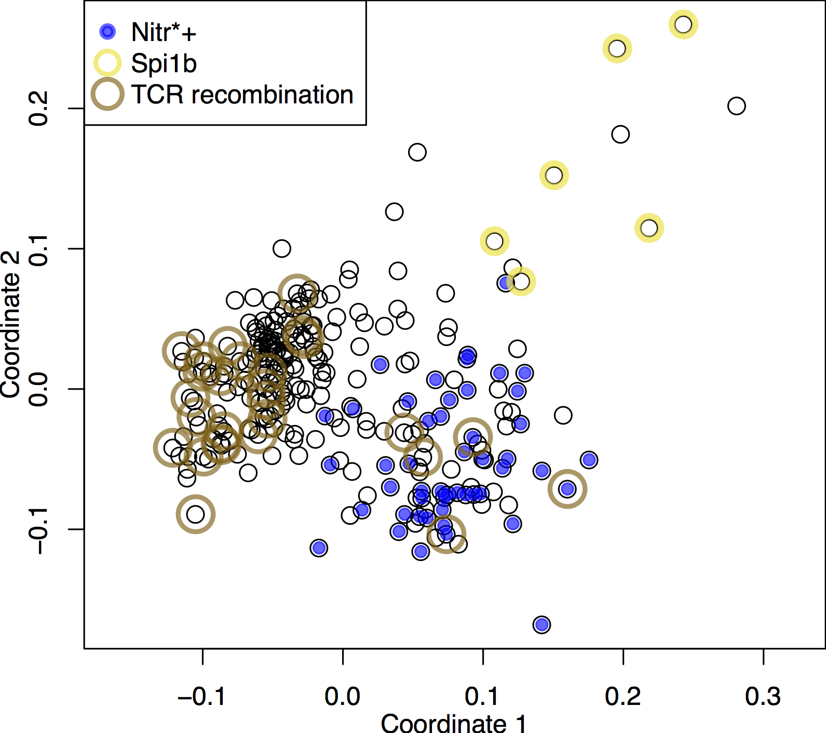
TCR reconstruction in the zebrafish example
Clear enrichment in reconstructed TCR in the T cell cluster.
Only successful for a subset of cells
  requires good coverage.
Only beta chain (alpha locus not annotated in zebrafish genome)
  requires good annotation

Slide 23
Promises of single-cell RNA-Seq
  Unbiased identification of (new) cell types
  Monitoring changes in gene expression in each cell type separately
  Predictions of new markers
  TCR or BCR reconstruction in T and B cells (more generally, DNA barcoding for cell tracking)
  Reconstruction of differentiation processes

Slide 24
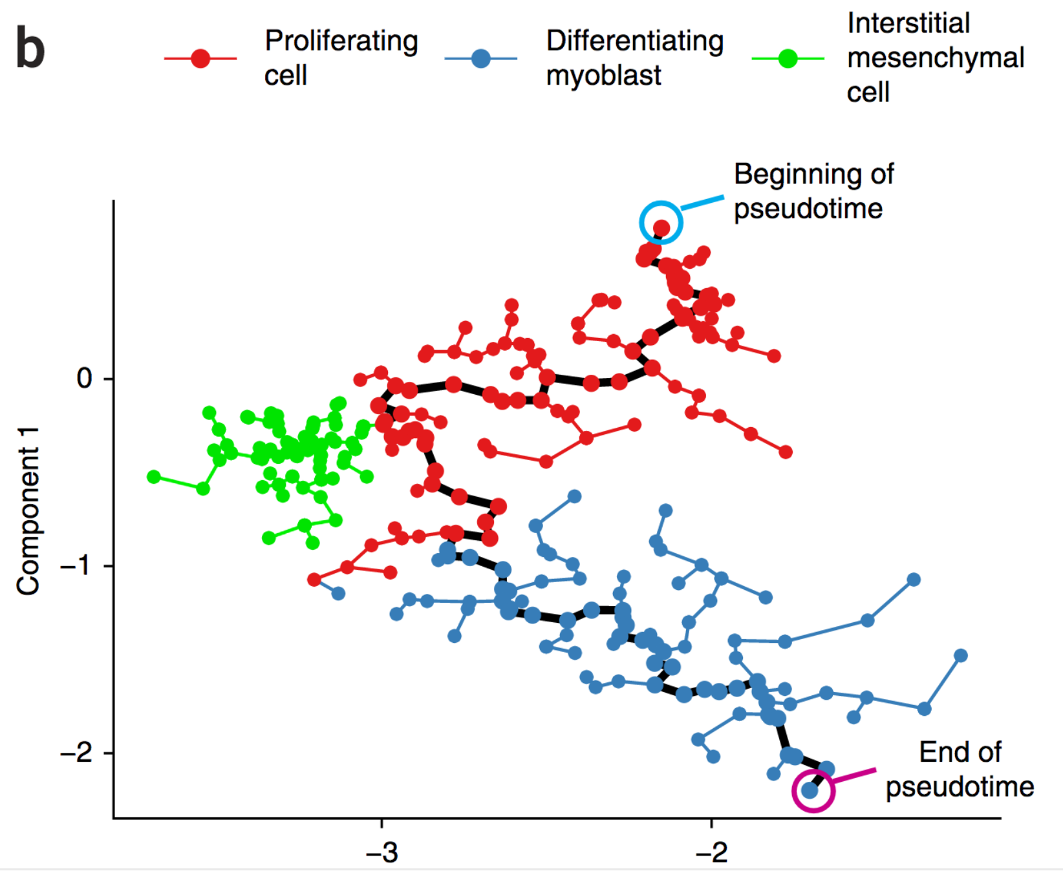
Cellular differentiation
Many different tools:
Monocle (Trapnell et al., Nat Biotech 2014)
reCAT (Liu et al., Nat Comm 2017)
Temporal mixture modeling (Lonneberg et al., Science Immunology, 2017)
Diffusion maps (Haghverdi et al., Bioinformatics 2015)
Find the best ordering of cells, assuming they represent a continuous differentiation process (“pseudo-time ordering”)
!!! Results are not always stable to different choices of parameters !!!

Slide 25
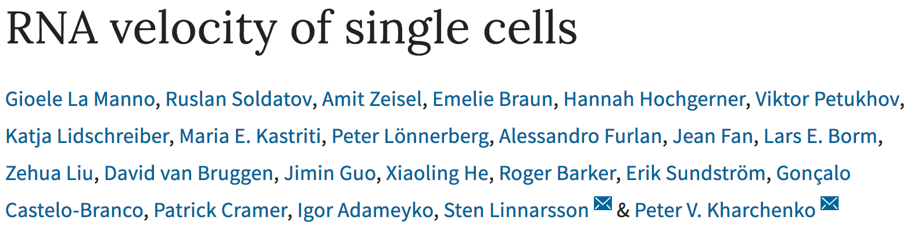
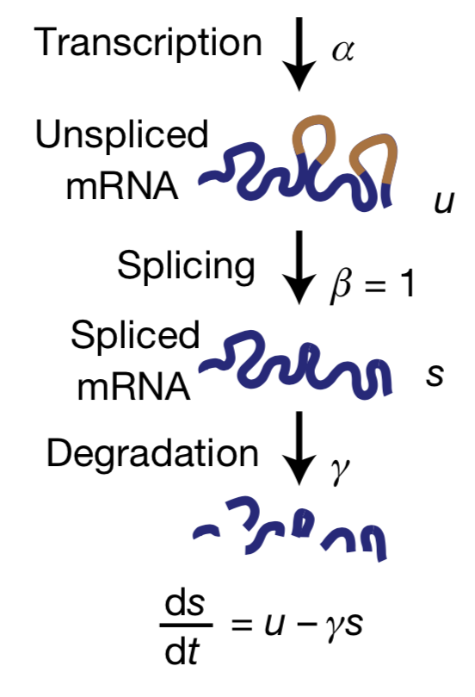
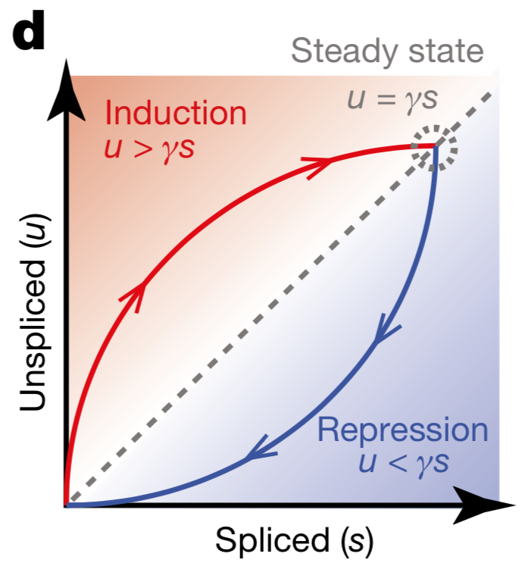
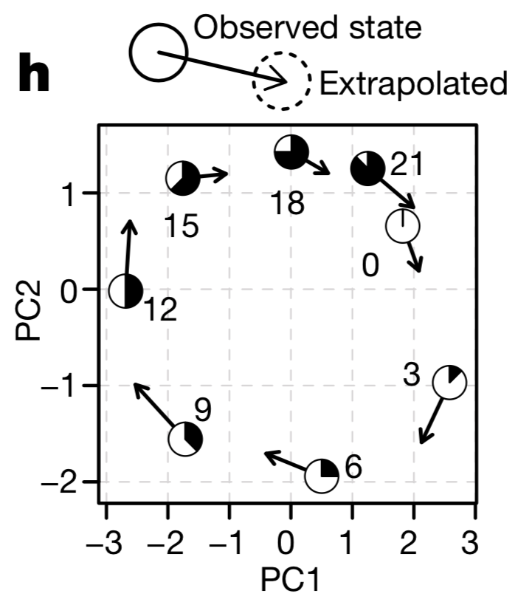
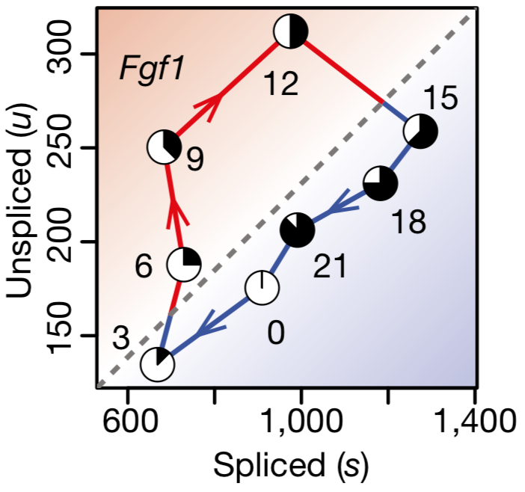
Directionality in differentiation trajectories
Inferring directionality of trajectories
Nature 2018
Cell cycle gene example
At early time points, genes have higher fraction of unspliced mRNA
Follow the evolution of a gene in the space of spliced vs unspliced mRNA.
Take an average over different genes

Slide 26
Single-cell RNA-Seq in cancer
Tumors contain both cancer and non-malignant cells
Cancer cells use non-malignant cells to grow
The interplay between cancer and non-malignant cells has impact of prognostic and response to therapy

Slide 27
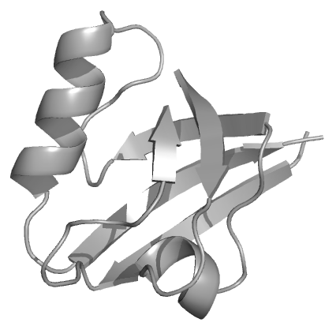
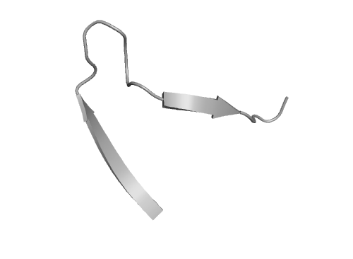


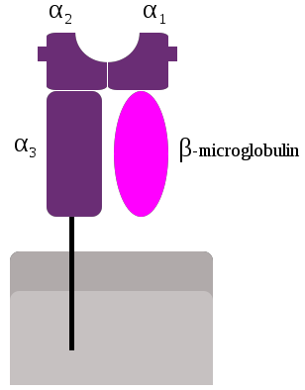
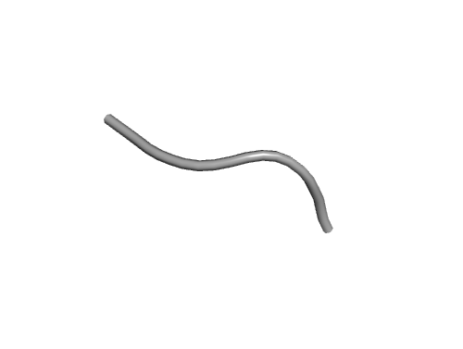

Single-cell RNA-Seq in cancer
Very short reminder of the basics of cancer immunotherapy (checkpoint blockade)
Cancer cell
T cell
Inhibitory receptors of T cell activity
Proteasome
HLA
TCR
PD-L1
PD1
CTLA4
B7
Inhibitors of inhibiting receptors:
Anti – CTLA4 (ipilimumab)
Anti – PD1 (nivolumab, pembrolizumab)
Antigen presenting cell

Slide 28
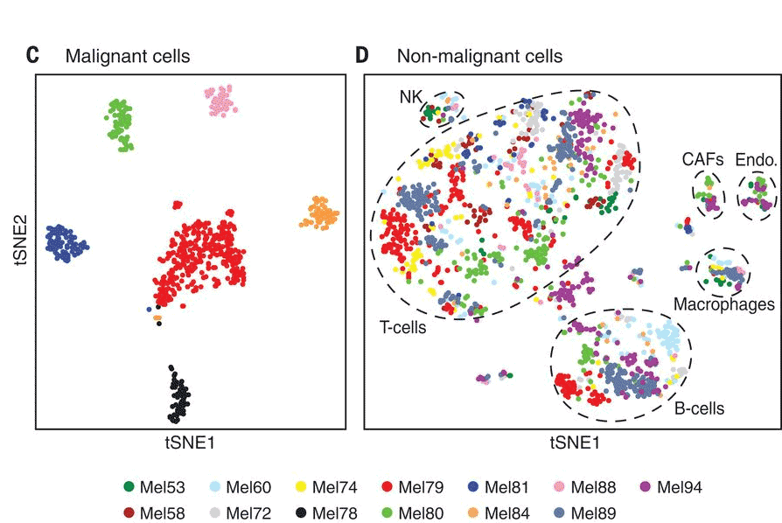
Single-cell RNA-Seq in cancer
Patel et al. Science 2014: Analysis of glioblastoma samples (but low quality data).
Tirosh et al. Science 2016 – first high quality analysis of cancer samples (melanoma).
19 melanoma patients.
Flow cytometry to load 96-well plates.
Single-cell sequencing of >4500 cells.
Cancer cells cluster by patients while non-malignant cells cluster by cell types

Slide 29
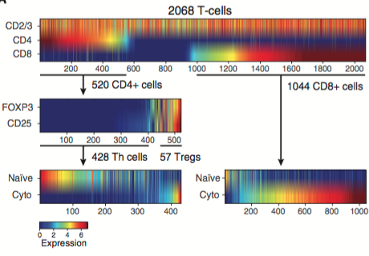
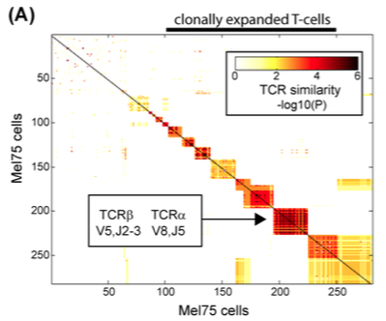
Tirosh et al.
Diversity of T cells
Evidence of clonal expansions

Slide 30
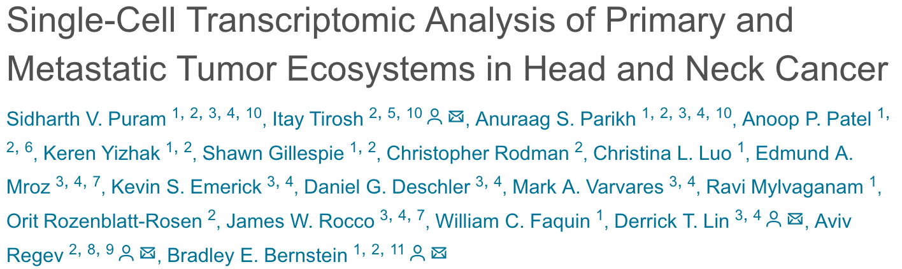
Single-cell RNA-Seq in cancer
Head and neck cancer.
Variable gene expression in cancer cells
Conserved gene expression in non-malignant cells across patients

Slide 31
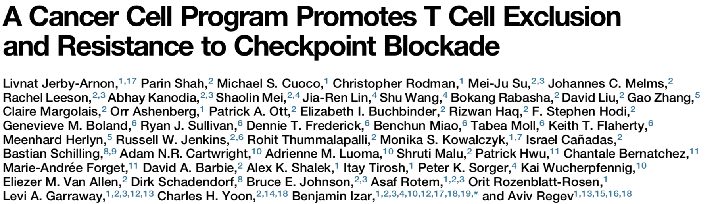
Single-cell RNA-Seq in cancer
Identification of cancer cell characteristics correlating with response to immunotherapy:
Cell 2018
Cell 2018
Investigating genes whose expression in cancer cells correlate with immune infiltrations and response to therapy
Main findings:
Immune related genes (antigen presentation, interferon, complement system) correlate with higher immune infiltrations and higher response to immunotherapy
CDK4, CDK7/Myc targets correlate with lower immune infiltration and lower response to immunotherapy

Slide 32
Summary
Unbiased view of the heterogeneity of tumors (cancer + non-malignant cells).
Similarity between immune cells across patients, differences in cancer cells.
Towards identifying interactions between different cell types.

Slide 33


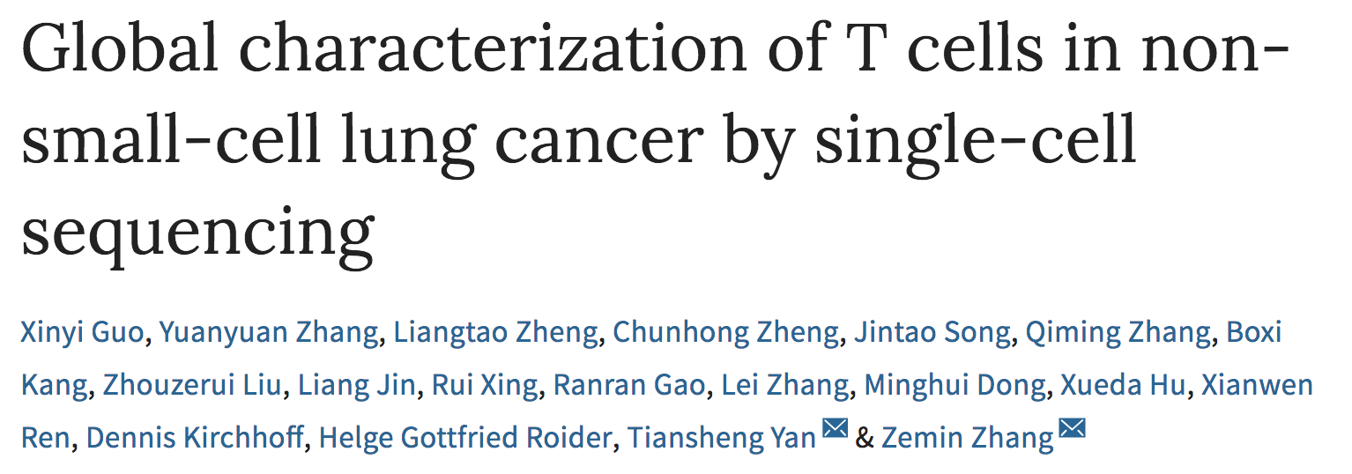
Focus on immune cells in tumors
Analysis of mouse tumor infiltrating CD8 T cells. Evidence of activated vs dysfunctional CD8 T cells.
Very nice scRNA-Seq data (but many issues with the interpretation of the data…).
Cell 2016
CD8 and CD4 T cells in liver cancer (>5000 cells).
Quite nice data
Cell 2017
12’000 T cells in lung tumors.
Heterogeneity among T cells, including a pre-exhausted state that correlates with better prognosis
Nature Medicine 2018

Slide 34
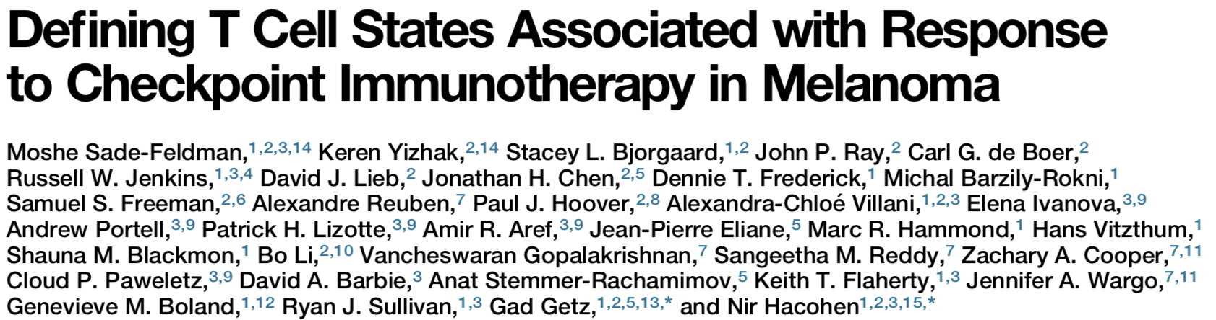
Focus on immune cells in tumors
Identification of cell types associated with response to immunotherapy:
Cell 2018
First in-depth study of cell types preferentially found in immunotherapy responder.
TCF7 (marker of memory) expressed on CD8 T cells is a very good marker.
Mechanistic understanding in LCMV (virus): Utzschneider et al. Immunity 2016.

Slide 35
Summary
Improved understanding of heterogeneity of immune cells in tumors.
Combined clonality and gene expression analysis.
Correlations between specific cell types and both survival and response to immunotherapy.

Slide 36
Specific challenges in single-cell RNA-Seq
Tissue dissociation and processing
  Dead cells, RNA degradation, doublets, changes in gene expression.
Transcript drop-outs (~10% efficiency):
  If you do not see a gene it does not mean that it is not there.
  If you see very high expression, it may not be as high as it looks like (amplification bias)
Batch effects:
  Often clusters correspond to different batches/plates.
Cell cycle and/or number of reads per cell:
  Even cells of the same type may look different at the single-cell gene expression level.
Big datasets!

Slide 37
Main challenges in scRNA-Seq
Transcript dropout
Use gene signatures obtained from cells showing expression of the markers

Slide 38
Summary
Single-cell RNA-Seq:
  Unbiased identification of (new) cell types
  Monitoring changes in gene expression in each cell type separately
  Predictions of new markers
  Reconstruction of differentiation processes
  TCR or BCR reconstruction in T and B cells (more generally, DNA barcoding for cell tracking)

Slide 39
Conclusion
Single-cell RNA-Seq is revolutionizing our ability to phenotypically interrogate complex samples/tissues.
=> Much more powerful than cell type predictions from bulk gene expression data, but also more expensive
Single-cell RNA-Seq enables us to predict differentiation trajectories
Single-cell RNA-Seq allows to follow barcoded cells (e.g., natural barcoding of TCR/BCR in immune cells)

